Slide 1


Final Year Project
Alzheimer's Disease Recognition Using Machine Learning
Presented by:
Abir Hadrich
Academic year:
2022/2023
Supervised by:
Mr. Yassine Ben Ayed

Slide 2
Plan
1
Introduction
4
Proposed Model
2
Alzheimer’s Disease
5
Conclusion
3
Related Work
1

Slide 3
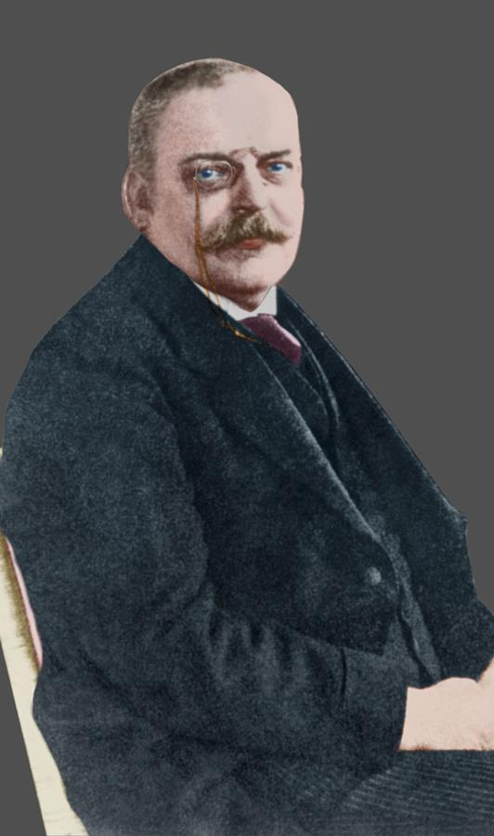
Introduction
Dr. Alois Alzheimer(June 1864 – 19 December 1915)
2

Slide 4
In 2023, over 46.8 million people worldwide, including 6.7 million Americans, have AD
Demographic | Percentage of the affected American people
75 years and older | 73%
Women | 67%
3

Slide 5
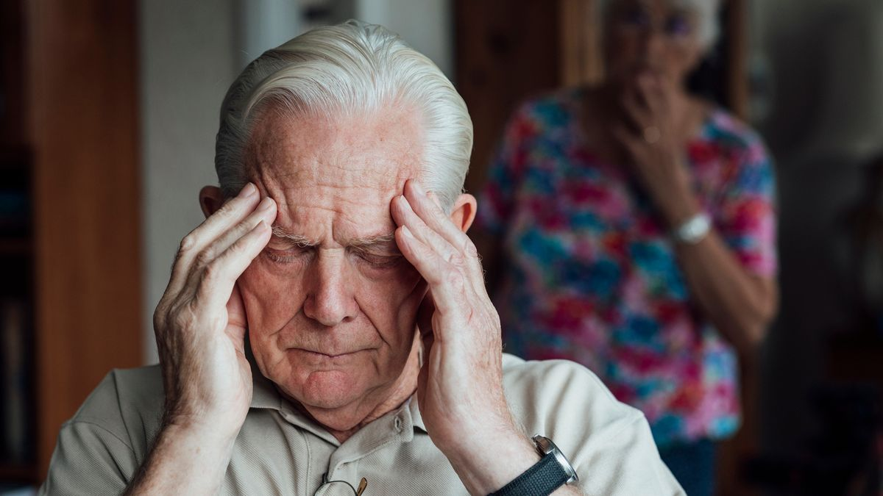
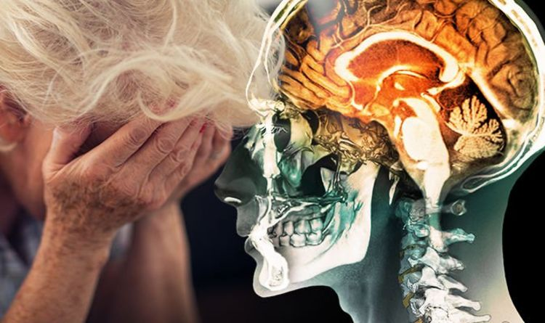
What are the symptoms of Alzheimer’s Disease?
What is Alzheimer’s Disease?
4

Slide 6

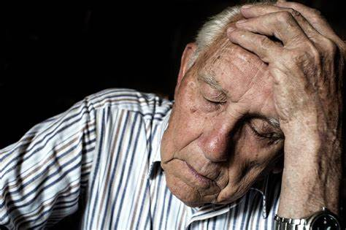



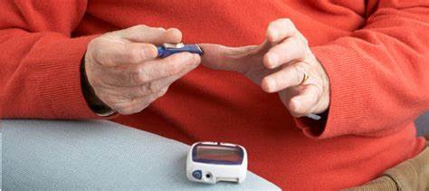
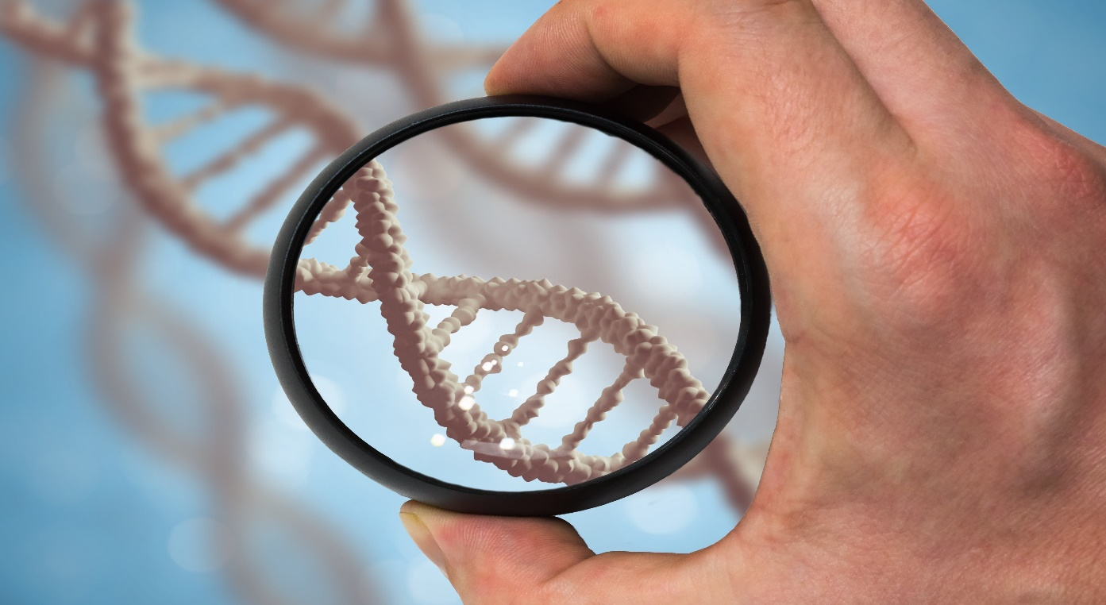
What are the factors contributing to Alzheimer’s Disease?
What are the consequences of Alzheimer’s Disease?
5

Slide 7
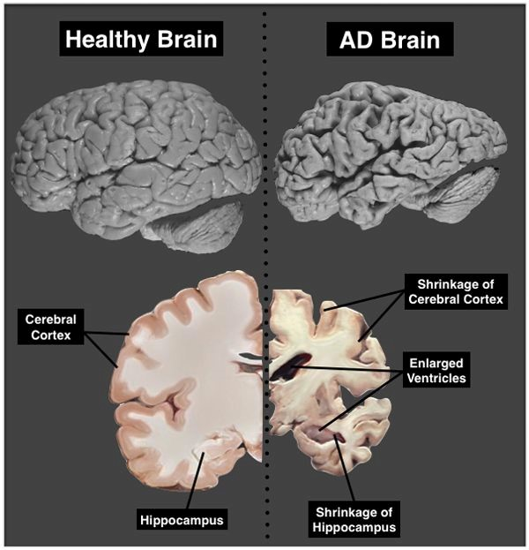
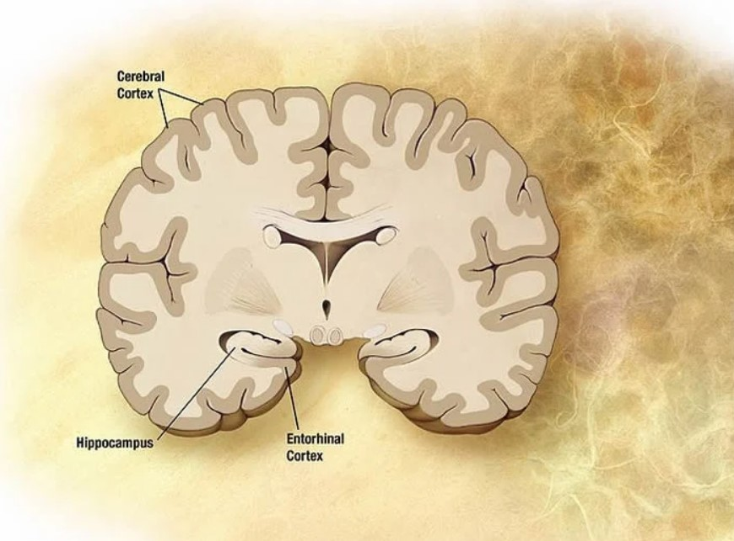
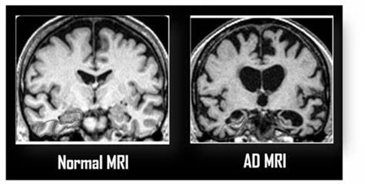
What are the key brain areas responsible of creating memories and consolidation?
What is the purpose of Medical Imaging?
How do specialists diagnose the Alzheimer’s Disease?
6

Slide 8
Projected Increase in Middle-Aged People with AD and Associated Costs (2022-2050)
7

Slide 9
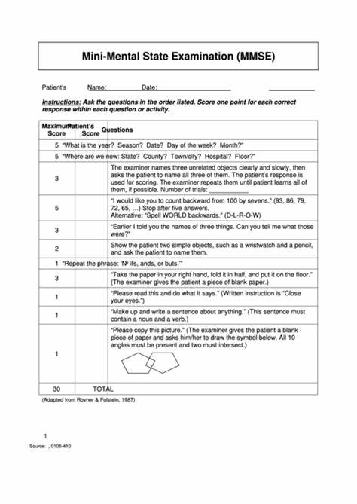
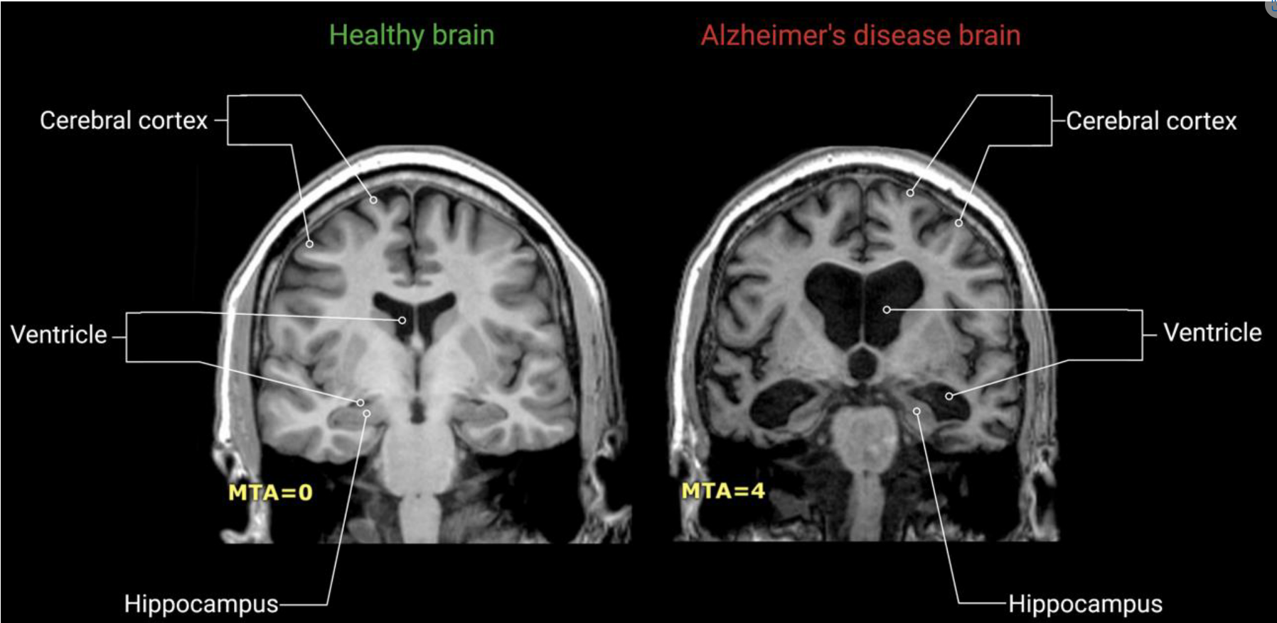
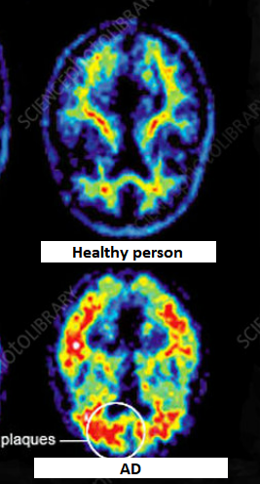
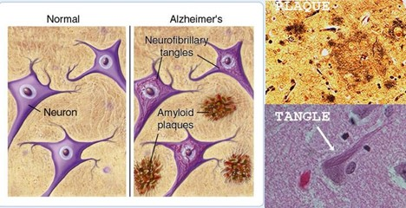
Screening Alzheimer's Disease
Brain Imaging
Cognitive Evaluations
Biomarkers
Magnetic Resonance Images
Beta-Amyloid and Tau proteins
Positron Emission Tomography
Mini-Mental State Examination
8

Slide 10
Related Work
9

Slide 11
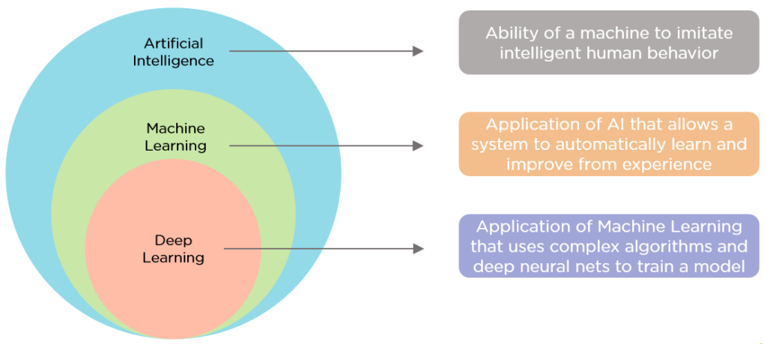
Artificial Intelligence:
Machine Learning vs Deep Learning
10

Slide 12
Machine Learning
- Comparative Table:
Reference | Year | Features Extraction Method | Classification Method | Dataset | Accuracy
Liu.M, Li.F, and Al. | 2020 | Convolutional Neural Network | Multi Layer Perceptron | Alzheimer’s disease neuroimaging initiative | 92.5% AD/NC, 77.5%MCI/NC,
Bansal.D , Khanna.k , and Al. | 2020 | Bag of features | Support Vector Machines | Alzheimer’s disease neuroimaging initiative | 86%
Raju.M, Gopi.V, and Al. | 2021 | Convolutional Neural Network | Multi Layer Perceptron | Alzheimer’s disease neuroimaging initiative | 96.66%
Tian. J, Smith.G, and Al. | 2021 | Convolutional Neural Network | Support Vector Machines | UK Biobank | 82.44%
11

Slide 13
Deep Learning
– Comparative Table:
Reference | Year | Extraction Features Method | Classification Method | Dataset | Accuracy
Shen.T, Jiang.J and Al | 2019 | Deep Belief Network | Support Vector Machines | Alzheimer’s Disease Neuroimaging Initiative | 86%
Fu'adah.Y , Wijayanto.I , and Al | 2021 | Convolutional Neural Network | Multi Layer Perceptron | AD dataset(4 class of images) | 95%
Tuan.P, Phan.T, and Al | 2022 | Auto-Encoders | Support Vector Machines | Alzheimer’s Disease Neuroimaging Initiative | 93.53%
12

Slide 14
Proposed Model
13

Slide 15
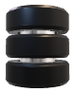
Dataset
System Architecture
Pre-Processing
Data
-Data combination
-Data augmentation
-Oversampling by ADASYN
MRI DATASET
70%
Training data
20%
Validation data
10%
Testing data
Features Extraction
InceptionV3
Prediction
Multi-Layer Perceptron
Classification
Non demented
Mild demented
Very Mild demented
Moderate demented
14

Slide 16
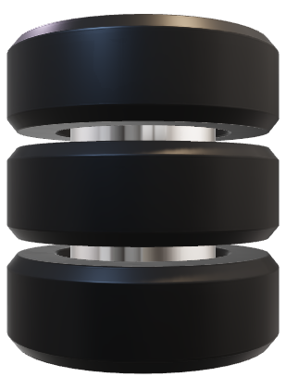
Data Acquisition
Database Description
Alzheimer Dataset (4 class of Images)
Sarvesh Dubey
Grayscale
Labels : ’Non-Demented’, ’Mild Demented’, ’Very Mild Demented’, and ’Moderate Demented’.
176x208 pixels
15

Slide 17
Dataset
System Architecture
Pre-Processing
Data
-Data combination
-Data augmentation
-Oversampling by ADASYN
MRI DATASET
70%
Training data
20%
Validation data
10%
Testing data
Features Extraction
InceptionV3
Prediction
Multi-Layer Perceptron
Classification
Non demented
Mild demented
Very Mild demented
Moderate demented
16

Slide 18
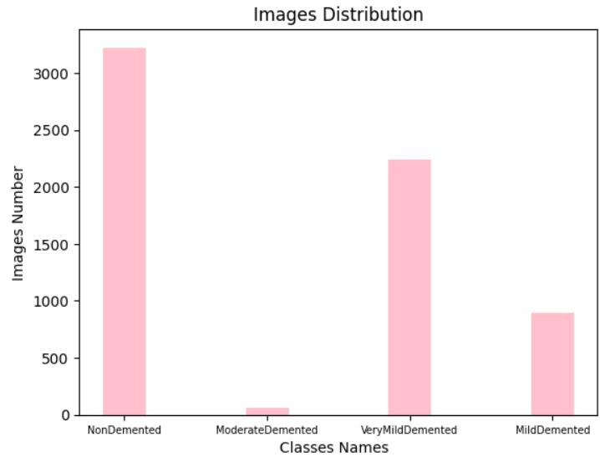

Image preprocessing
* Images Distribution of New Dataset: Bar Chart visualization
Data Combination
New dataset
--> Imbalanced Dataset
17

Slide 19
Data Augmentation
Data Oversampling
Description | Value
Library | Keras
Class Used | ImageDataGenerator
Transformations | Zooming, brightness adjustment, horizontal flipping, data format, filling mode and rescale
Image Size | 160 * 160 pixels
Data Retrieval | Augmented data in batches
Description | Value
Number of samples after oversampling | 12394
Height of each image | 160
Width of each image | 160
Number of color channels | 3
Number of labels | 4
18
2-2-3 Data Oversampling

Slide 20
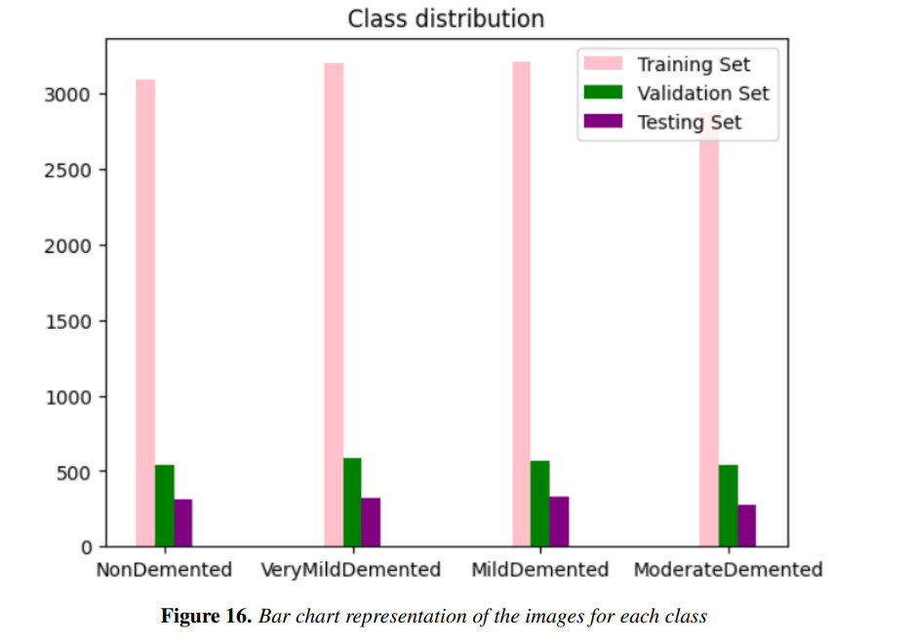
Data Splitting
Dataset | Percentage Split
Training Set | 70%
Validation Set | 20%
Test Set | 10%
Balanced classes!
19

Slide 21
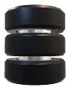
Dataset
System Architecture
Pre-Processing
Data
-Data combination
-Data augmentation
-Oversampling by ADASYN
MRI DATASET
70%
Training data
20%
Validation data
10%
Testing data
Features Extraction
InceptionV3
Prediction
Multi-Layer Perceptron
Classification
Non demented
Mild demented
Very Mild demented
Moderate demented
20

Slide 22
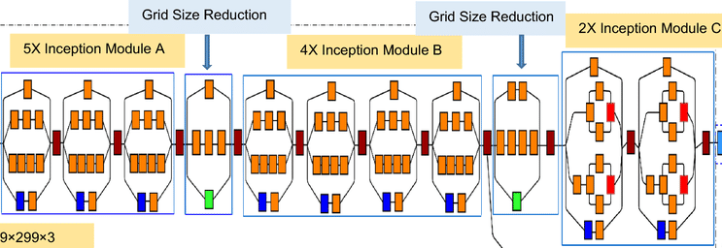
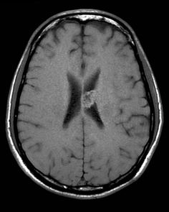
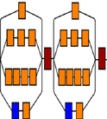
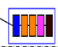
Features extraction
C
Input Image
Auxiliary classifier
Flattening layer
Output Vector
21

Slide 23
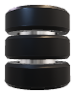
Dataset
System Architecture
Pre-Processing
Data
-Data combination
-Data augmentation
-Oversampling by ADASYN
MRI DATASET
70%
Training data
20%
Validation data
10%
Testing data
Features Extraction
InceptionV3
Prediction
Multi-Layer Perceptron
Classification
Non demented
Mild demented
Very Mild demented
Moderate demented
22

Slide 24
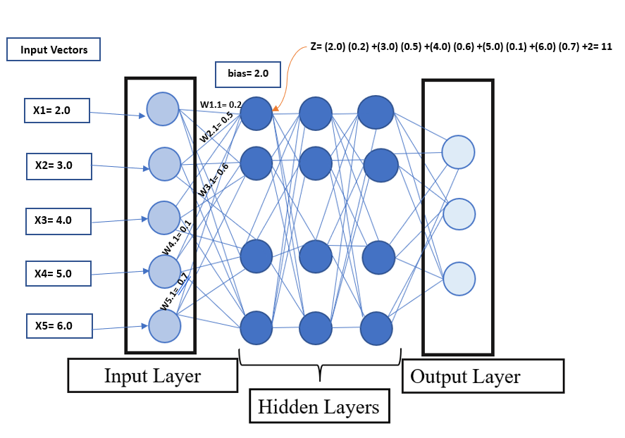
Multi Layer Perceptron for Classification
23

Slide 25
Alzheimer Dataset (4 class of Images)
12394 images
RGB
160x160 pixels
Labels : ’Non-Demented’, ’Mild Demented’, ’Very Mild Demented’, and ’Moderate Demented’.
24

Slide 26
Evaluation Metrics
Metrics | Formulas
Accuracy | TP + TN / (TP + FP + TN + FN)
Precision | TP / (TP + FP)
Recall | TP / (TP + FN)
F1 Score | 2 * Precision * Recall / (Precision + Recall)
25

Slide 27
Experiments and Evaluations
ZERO Hidden layers
Input layer Nodes | Accuracy | Precision | Recall | F1-Score
18432 | 77.25% | 85% | 77% | 80.8%
ONE Hidden layer
Neurons Numbers | Accuracy | Precision | Recall | F1-score
400 | 96.18% | 96% | 96% | 96%
500 | 97.44% | 98% | 97% | 97%
650 | 96.31% | 96% | 96% | 96%
800 | 96.22% | 96% | 96% | 96%
26

Slide 28
TWO Hidden layers
Neurons Number | Accuracy | Precision | Recall | F1-score
50 | 88.41% | 92% | 88% | 88%
100 | 95.32% | 95% | 95% | 95%
200 | 92.25% | 94% | 92% | 92%
300 | 94.75% | 95% | 95% | 95%
500 | 94.84% | 95% | 95% | 95%
Epochs Number Variations
Epochs Numbers | Accuracy | Precision | Recall | F1-Score
10 | 91.80% | 92% | 92% | 92%
30 | 97.44% | 98% | 97% | 97%
50 | 92.72% | 93% | 93% | 93%
80 | 95.70% | 95% | 95% | 95%
100 | 91.74% | 93% | 91% | 92%
27

Slide 29
Learning Rate Variations
Learning Rate | Accuracy | Precision | Recall | F1-Score
0.00001 | 91.74% | 93% | 91% | 92%
0.0001 | 97.44% | 98% | 97% | 97%
0.001 | 90.87% | 91% | 91% | 91%
0.01 | 62.51% | 65% | 62% | 63%
Dropout Variations
Dropout Rate | Accuracy | Precision | Recall | F1-Score
0.2 | 87.19% | 90% | 87% | 87%
0.5 | 97.44% | 98% | 97% | 97%
0.7 | 93.50% | 94% | 93% | 93%
28

Slide 30
Studies Results Comparison
Reference | Year | Feature Extraction | Classification | Dataset | Accuracy
Shen.T, Jiang.J, and Al | 2019 | DBN | SVM | ADNI | 86%
Bansal.D, Khanna.K and Al | 2020 | The Bag of features | SVM | ADNI | 86%
Raju.M, Gopi.V and Al | 2021 | CNN | MLP | ADNI | 96.66%
Fu'adah.Y, Wijayanto.I, and Al. | 2021 | CNN (AlexNet) | MLP | AD dataset(4 class of images) | 95%
Tuan.P, Phan.T and Al | 2022 | Auto-Encoders | SVM | ADNI | 93.53%
Proposed Model | 2023 | CNN (InceptionV3) | MLP | AD dataset(4 classes) | 97.44%
29

Slide 31
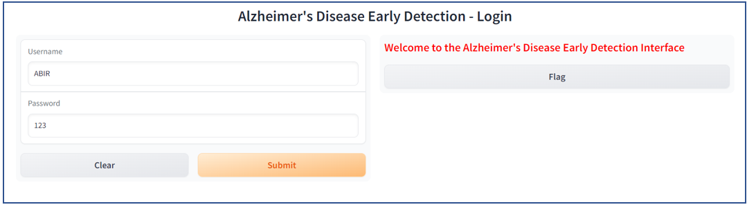
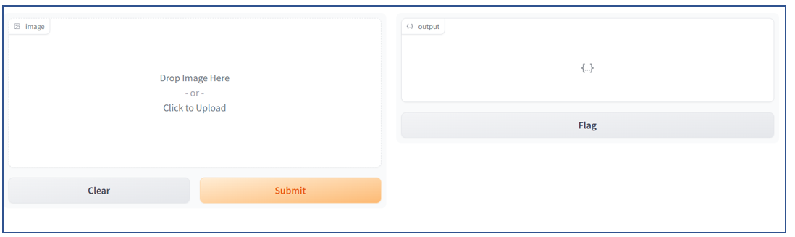
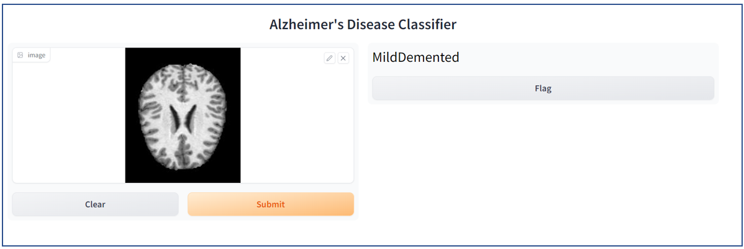
Graphical User Interfaces
Authentication
Image Selection
Classification
30

Slide 32
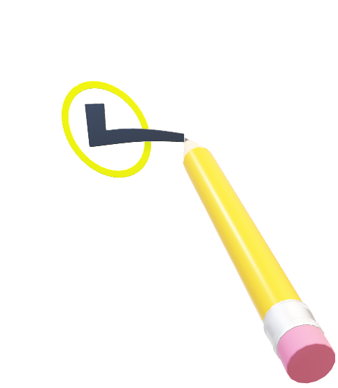
Conclusion and Perspectives
31

Slide 33

Conclusions:
The main goal of our proposed model is to develop an effective system for the early detection of Alzheimer's Disease using Medical Images.
Our Proposed Model achieved an accuracy rate of 97.44% with InceptionV3 and MLP models.
The pre processing techniques we applied helped us to achieve a better accuracy than the chosen reference
Perspectives:
We will test our proposed model on more Alzheimer databases
Explore the interfaces with different medical images for diagnosing various diseases
32

Slide 34
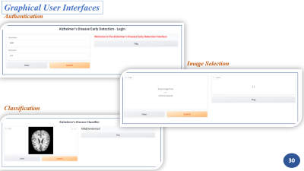
Your Attention is utterly appreciated!
33

